Slide 1
Adult Arrests 18 and Older by County: Beginning 1970 AIT-580-005
By
KEERTHANA CHERUVU

Slide 2
Introduction:
The dataset consist of Adult Arrests 18 and Older by County-Beginning 1970 derived from the finger-printable offences.
It describes about the total misdemeanor cases and felony cases that occurred in all the counties over the years.
The drug felony cases and drug misdemeanor cases are described as well.

Slide 3
Research Questions:
Changes occurred in the Felony with Misdemeanor Cases over the counties and years.
The county recorded maximum number of crimes.
Maximum number of felony and Misdemeanor drug crimes recorded over the years.

Slide 4
Methods and Tools Used:
Tools used: R studio, Python Jupyter, MySQL
Methods used: ggplot, ggcorr, regression model, histograms
Python and R languages are used for visualizations of the dataset.
SQL is used for performing the queries such as distinct values for the felony and misdemeanor cases.

Slide 5
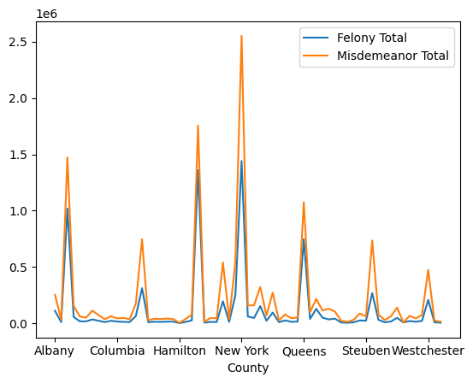
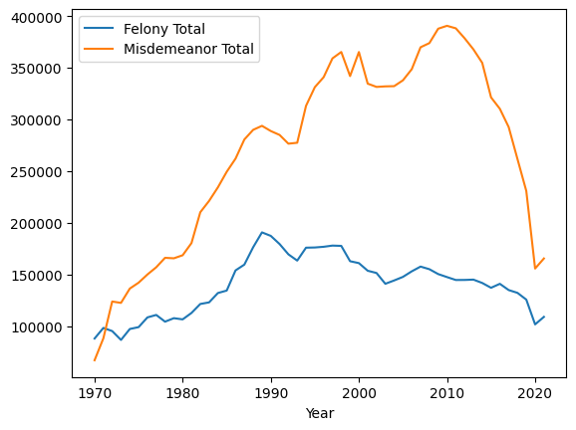
Felony and Misdemeanor Cases in the counties over the years:

Slide 6
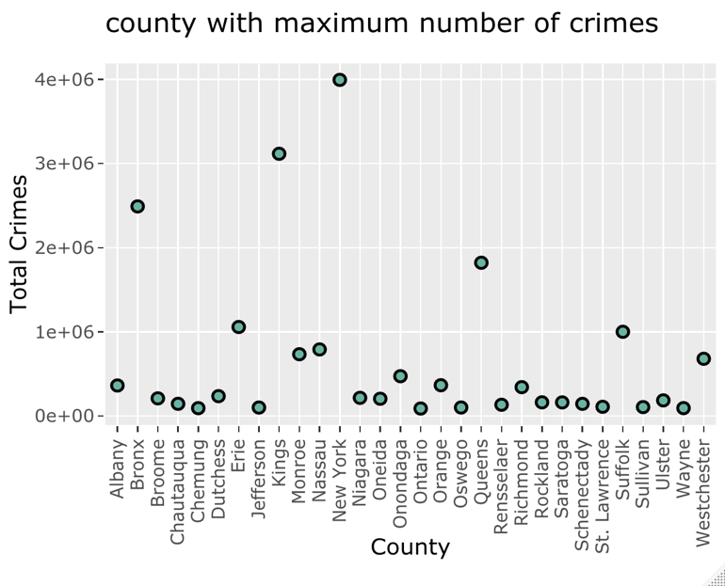
County with maximum number of crimes:

Slide 7
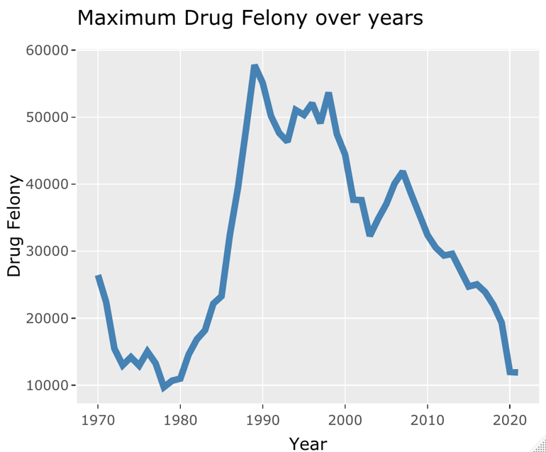
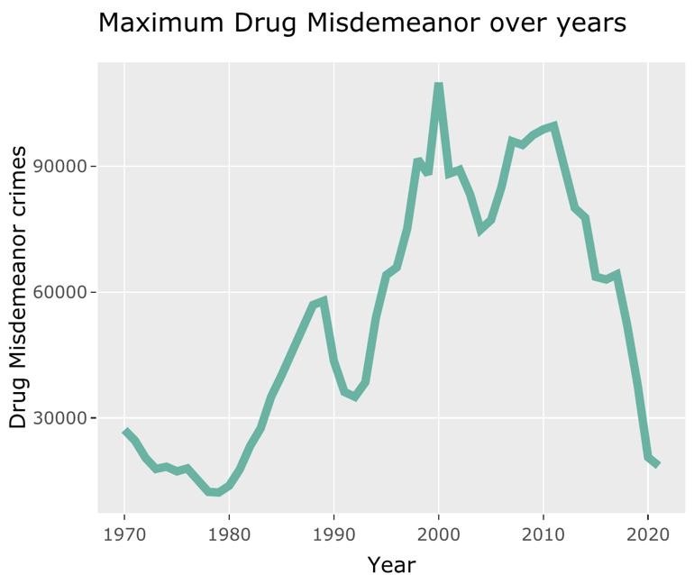
Maximum drug felony and misdemeanor cases over the years:

Slide 8
Lessons Learned
Analyzing the data, literature survey and framing the research questions.
Analyzed the dataset using the visualization techniques using r and python languages.
Using multiple tools such as r studio, python jupyter, MYSQL
Performing the queries in SQL language.

Slide 9
THANKYOU

